Slide 1




TB 2018 – Bridging the TB and HIV Communities, Amsterdam, Netherlands, 22 July 2018
WHO Consolidated guidelines for
TB preventive treatment:
Updates and highlights
Annabel Baddeley
World Health Organization

Slide 2

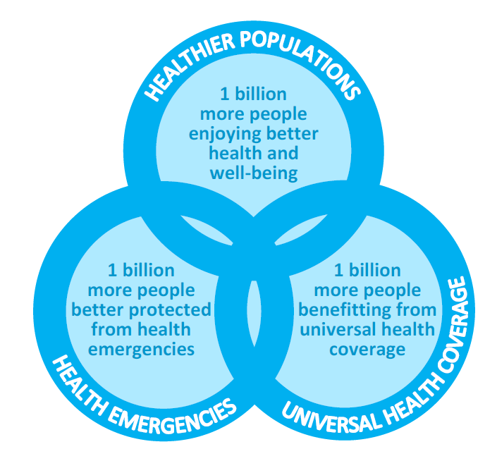

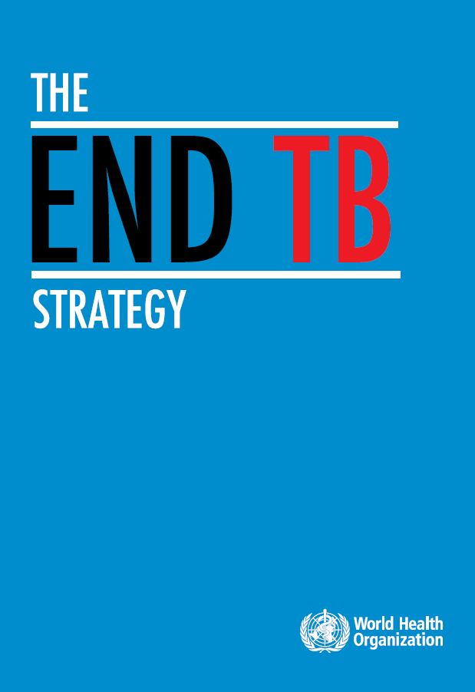
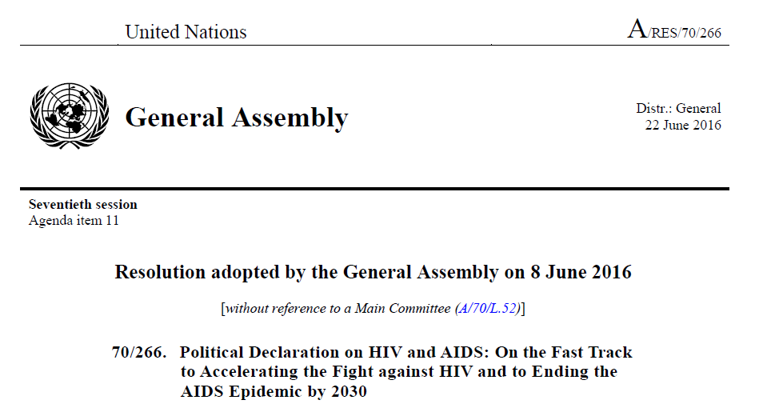

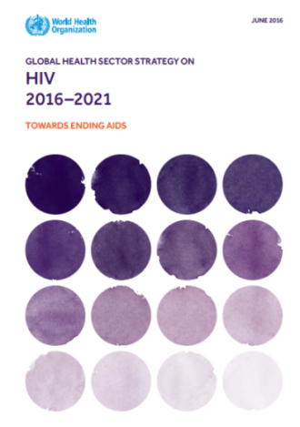
SDGs, Universal Health Coverage and GPW: Key opportunities to End TB and AIDS by 2030
WHO GENERAL PROGRAMME OF WORK
SDG target on ending epidemics is at the intersection of the 3 billion goals
Target 3.3: By 2030, end the epidemics of AIDS, tuberculosis ….
Leave no-one behind –
health is a human right
Treat the person
not the disease
End TB Strategy targets:
90% reduction in TB deaths by 2030
80% reduction in TB incidence rate
0% TB affected families facing
catastrophic costs
HIV Strategy and
UN 2016 Political Declaration:
Reduce TB deaths among
people living with HIV
by 75% by 2020
Notes:
TB prevention as a whole sits at the heart of universal health coverage. TB prevention, including TB Preventive treatment is a critical component of the WHO End TB Strategy – without it we will not achieve global targets to end TB and AIDS.
008

Slide 3
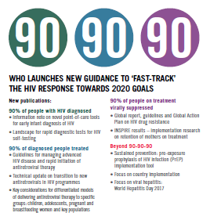
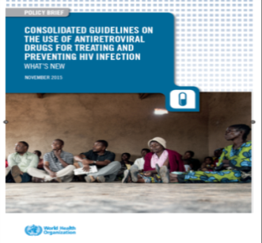
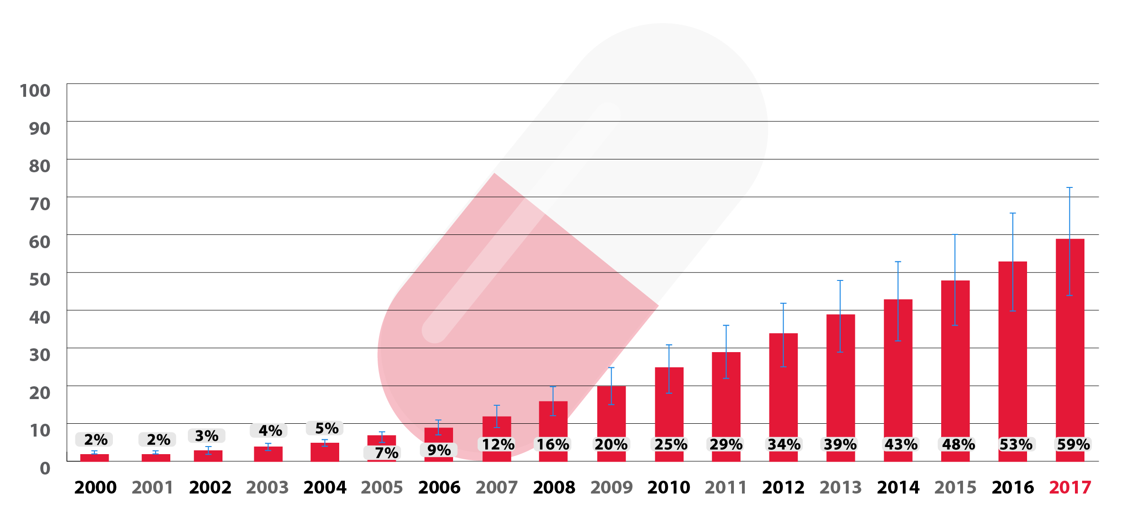
Impressive scale-up of ART in People living with HIV
21.7 million PLHIV receiving ART by Dec 2017
59% of 36.9M PLHIV
Source: UNAIDS/WHO estimates
Notes:
There has been impressive scale-up of ART which will have had considerable impact on reducing HIV-associated TB. Latest data have close to 22 million receiving ART by the end of last year.

Slide 4
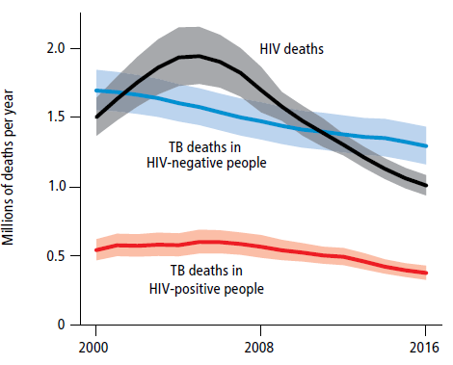
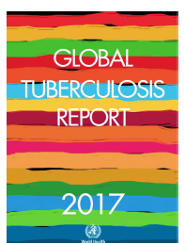


Trends of Estimated TB and HIV deaths, 2000–2016
37% of the 1 million AIDS deaths in 2016 were due to TB
Source: Global TB Report, 2017
Notes:
and can see from this graph that HIV deaths are dropping but TB deaths are dropping at a much slower pace. 37% of the 1 million AIDS deaths in 2016 were due to TB.

Slide 5
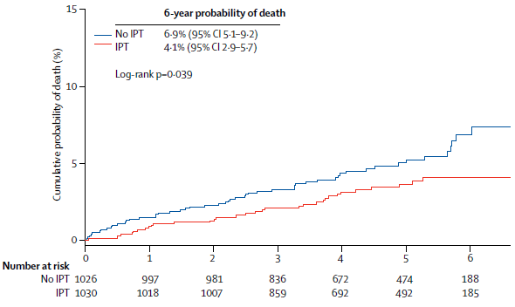
TB preventive treatment reduces
AIDS-related Mortality: TEMPRANO
Temprano Trial
Long Term Follow-Up
37% reduction in TB mortality in PLHIV with high CD4 counts, after 6 months of IPT, independent of ART
Badje et al, Lancet Glob Health 2017; 5:e1080-89
Notes:
The Temprano trial has shown the impact of TB preventive treatment on reducing deaths – even after long term follow-up and at high CD4 counts.

Slide 6
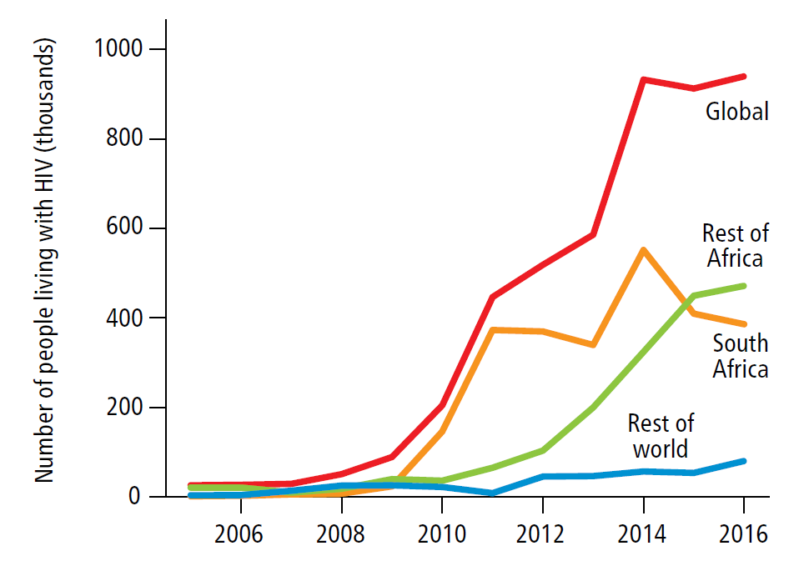
Initiation of TB preventive treatment to People living with HIV, 2005-2016
Source: Global Tuberculosis Report 2017
Only 12/30 high TBHIV burden countries reported on IPT in 2016
Notes:
Yet despite this progress has been limited.
Graph shows countries reporting implementation of IPT in PLHIV up until 2016 worldwide.
Only 60 countries reported in 2017 –including 12 of the 30 high burden countries.

Slide 7
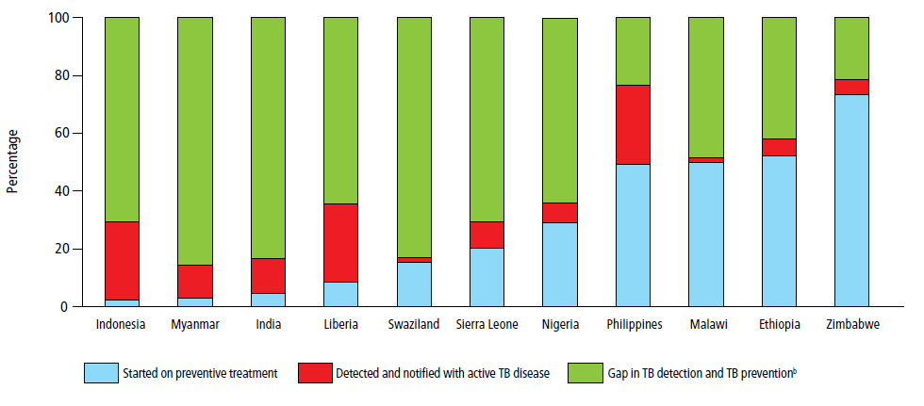
Gap in TB detection and TB preventive treatment for people who were newly enrolled in HIV care in high burden countries in 2016
71%
86%
83%
64%
83%
71%
64%
23%
48%
42%
21%
Source: Global Tuberculosis Report 2017
Considerable gaps in coverage in reporting countries with high burden of TB and HIV-associated TB
Notes:
This bar chart shows gaps in green of people newly enrolled in HIV care that have either not been detected with TB or who have not been initiated on TB preventive treatment. So among countries reporting TB prevention, the gap ranges from as high as 86% to 21%.

Slide 8
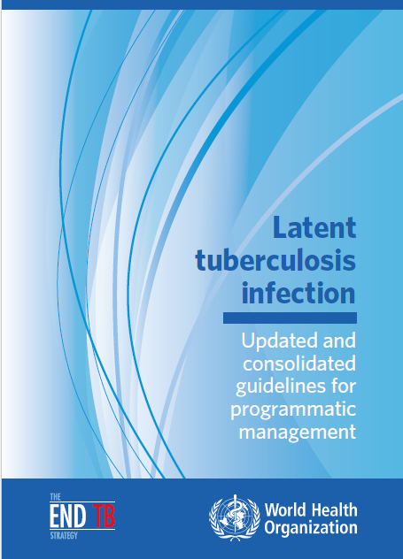
Consolidated and updated guidelines, 2018
24 recommendations
  10 existing and valid
  7 updated
  7 new
Focus on
  Risk group identification
  Algorithms to rule out TB
  Testing options
  Treatment options
Notes:
In 2018 WHO consolidated and updated existing guidance on LTBI.
Previously recommendations were dispersed in various WHO guidance and the recommendations were not aligned in high and low burden settings.
The new guidelines focus on risk group identification, algorithms to rule out TB, testing options and treatment options.
I will focus here on what’s new for high burden settings

Slide 9

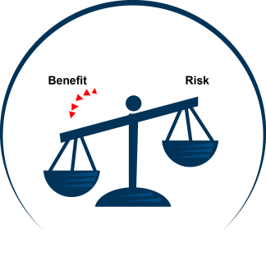
- Guiding Principle -
The Guideline Development Group used the guiding principle that individual benefit outweighs risk as the mainstay of recommendations on LTBI testing and treatment
Notes:
As with all guidelines, the Guideline development group used the guiding principle that individual benefit outweighs risk as the mainstay of recommendations on LTBI testing and treatment and

Slide 10
Priority risk groups for
LTBI testing and treatment
Strong recommendations
(All settings)
People living with HIV
Children < 5y old with contact to a pulmonary TB
Clinical indications
  Silicosis
  Anti-TNF treatment
  Dialysis
  Transplantation
Notes:
In the new guidelines, people living with HIV are still a priority risk group in all settings.

Slide 11
Risk groups for LTBI testing and treatment
Conditional recommendation
(New)
HIV negative children aged ≥ 5 years, adolescents and adults who are household contacts of people with bacteriologically confirmed pulmonary TB
Age (years) | LTBI-positive at baseline |  |  |  | Regardless of baseline LTBI status
 | Follow-up < 12 months |  | Follow-up < 24 months |  | Follow-up < 12 months |  | Follow-up < 24 months
 | No. of studies | Risk ratio | No. of studies | Risk ratio | No. of studies | Risk ratio | No. of studies | Risk ratio
General population | – | 1.0 (reference) | – | 1.0 (reference) | – | 1.0 (reference) | – | 1.0 (reference)
0–4 | 2 | 24.3 (0.73–811.0) | 3 | 22.9 (7.7–68.6) | 3 | 25.9 (16.9–39.7) | 5 | 14.8 (9.8–22.3)
5–14 | 2 | 27.1 (17.5–54.1) | 3 | 8.2 (2.3–29.4) | 3 | 24.1 (16.9–34.4) | 5 | 6.3 (2.9–13.7)
≥ 15 | 1 | 30.7 (17.5–54.1) | 2 | 13.4 (9.5–18.8) | 1 | 24.7 (14.2–43.0) | 3 | 11.7 (7.6–18.0)
Notes:
HIV negative children of 5 and over, adolescents and adults is a new group eligible group for high burden settings, aligning with the recommendation in low burden settings.
A previous systematic review was updated for high burden countries and found that household contacts regardless of age or LTBI status were at substantially higher risk for progression to active TB than the general population.
Preventive treatment is recommended conditionally in this group depending on availability of resources and capacity of health infrastructure to assess intensity and risk of exposure, and risks and benefits.

Slide 12
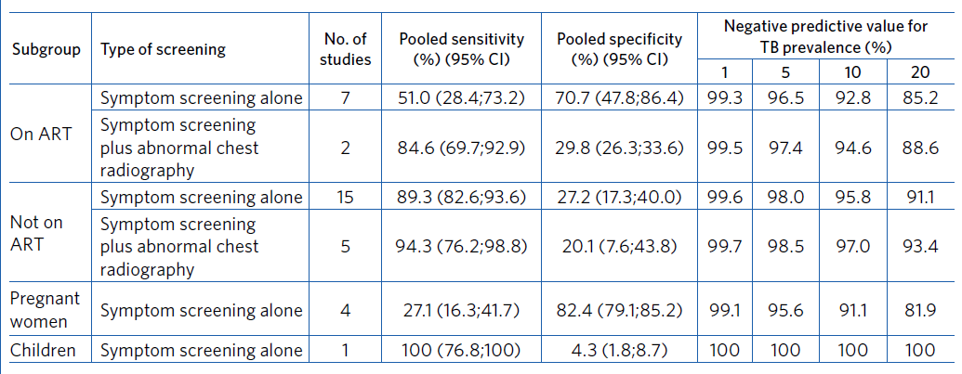
Algorithm to rule out active TB in PLHIV
Absence of any of the symptoms of current cough, fever, weight loss or night sweats.
Chest radiography may be offered to people living with HIV and on ART and preventive treatment given to those with no abnormal radiographic findings. (New)
BUT chest radiography should not be a requirement for initiating preventive treatment
Notes:
The original 4-symptom screening algorithm to rule out active TB was developed, based on evidence when ART coverage was low.
For these guidelines a systematic review was conducted to assess the performance of the symptom screen for people living with HIV who were on ART and not on ART.
The review found very low sensitivity of the symptom screen among those on ART, and that X-ray really increased sensitivity. So we have a new recommendation that chest radiography may be offered in people living with HIV and on ART and preventive treatment given to those with no abnormal radiographic findings.
But chest radiography should not be a requirement for initiating preventive treatment.

Slide 13
Testing for LTBI
Either TST or IGRA( QuantiFERON®-TB Gold In-Tube and T-SPOT®.TB) can be used to test for LTBI (New)
Head to head comparison of IGRA and TST for prediction of active TB [5 studies (N=7,769)]
TST =1.49 (95%CI 0.79;2.80)
IGRA=2.03 (95% CI: 1.18; 3.50)
BUT LTBI testing by TST or IGRA is not a requirement for initiating preventive treatment among PLHIV and contacts under 5 years
Notes:
Head to head comparison of evidence in high burden countries found no statistically significant difference between IGRA and TST so the new recommendation was made for high burden countries – aligning recommendations with low burden countries.
But LTBI testing by TST or IGRA is not a requirement for initiating preventive treatment

Slide 14
Treatment options
3RH should be offered as an alternative to 6H for children and adolescents aged < 15 years. (New)
3HP treatment may be offered as an alternative to 6H for both adults and children in countries with a high TB incidence.(New)
 | Intervention | Comparator | N | Active TB | Mortality | AEs | Hepato-toxicity | Completion rate
Adults with HIV | 3HP | 6H or 9H | 2 | 0.73 (0.23- 2.3) | 0.75 (0.44 - 1.27) | 0.63 (0.43 - 0.92) | 0.26 (0.12 - 0.55) | 1.25 (1.01-1.55)
 | 3HP | continuous INH | 1 | 1.50 (0.69-3.27) | 1.06 (0.47-2.41) | 0.20 (0.12-0.32) | 0.05 (0.02-0.13) | 1.59 (1.40-1.80)
Adults without HIV | 3HP | 9H | 1 | 0.44 ( 0.18-1.07) | 0.75 (0.47-1.19) | 0.87 (0.73-1.04) | 0.16 (0.10- 0.27) | 1.19 (1.16- 1.22)
Children and adolescents | 3HP | 9H | 1 | 0.13 (0.01-2.54) | 0.18 (0.01-3.80) | 0.88 (0.32-2.40) | - | 1.09 (1.03-1.15)
Notes:
So now in addition to Isoniazid monotherapy, WHO recommends also 3 month regimen of rifampicin and isoniazid for children under 15, and a three month regimen of isoniazid and rifapentine for adults and children.
Updated systematic reviews were conducted to compare 3 months daily rifampicin and isoniazid, and rifapentine and isoniazid weekly for 3 months with isoniazid monotherapy.
The guideline group found that the rifamycin-based regimens were as effective, but the risk of adverse events was lower and these new regimens were associated with higher completion rates.

Slide 15
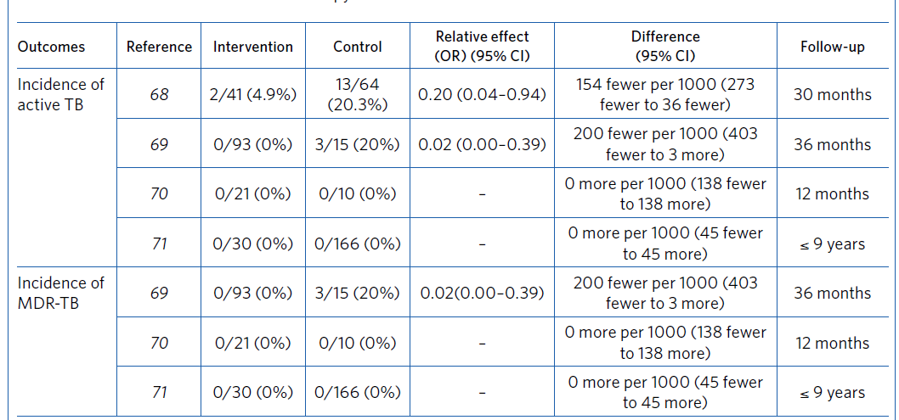
Preventive treatment for MDR-TB contacts
In selected high-risk household contacts of patients with multidrug-resistant tuberculosis, preventive treatment may be considered based on individualized risk assessment and a sound clinical justification. (New)
Notes:
Based on the available evidence from 4 studies, the GDG judged that the potential benefits of targeted preventive treatment for MDR-TB contacts based on individual risk assessments outweighed the harms.
So a conditional recommendation to consider preventive treatment to selected high-risk household contacts of patients with MDR-TB based on individualized risk assessment and sound clinical justification.

Slide 16
Preventive treatment for MDR-TB contacts-Remarks
Individualize treatment after a careful assessment of: the intensity of exposure, the certainty of the source case, reliable information on the drug resistance pattern of the source case and potential adverse events.
Only to household contacts at high risk (e.g. children, people receiving immunosuppressive therapy and people living with HIV).
Drugs should be selected according to the drug susceptibility profile of the source case.
Confirmation of infection with LTBI tests is required.
Strict clinical observation and close monitoring for at least 2 years.
This recommendation must not affect on-going placebo-controlled clinical trials of MDR-TB contacts on ethical grounds. The results of such clinical trials are crucial for updating this recommendation.

Slide 17
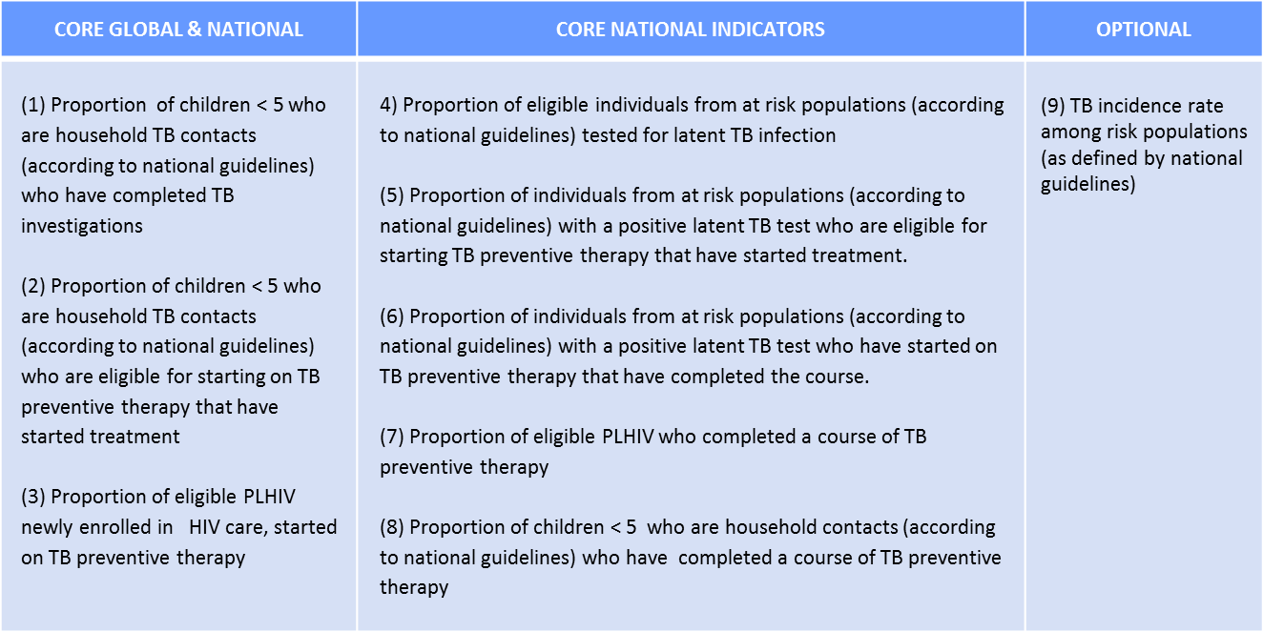
Monitoring and evaluating LTBI implementation
Aligned with national M & E systems
Standardized indicators should be used
Surveillance to monitor resistance to drugs used to treat LTBI
Tools to support M & E and scale up developed
Notes:
Programmatic management of LTBI should include monitoring and evaluation systems that are aligned with national patient M&E systems.
Appropriate recording and reporting tools should be developed and standardized indicators used to inform decision-making for programme implementation.
It is important also to monitor to resistance to drugs used to treat LTBI.
WHO is developing a tool to assist countries in improved implementation of programmatic management of LTBI, which will include also support for M&E.

Slide 18
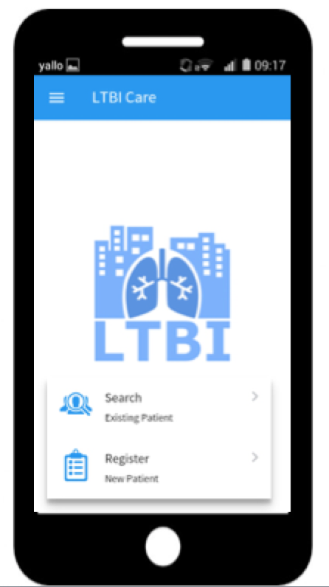
LTBI digital tool key characteristics
Free – downloadable from WHO website
Adaptable - to country specific context and needs
Functional - on mobile devices
Flexible - record data off line and synchronise later and use local server
https://www.youtube.com/watch?v=QxJknYG53jM
Notes:
Also launched with the guidelines was this digital tool to capture the data.

Slide 19
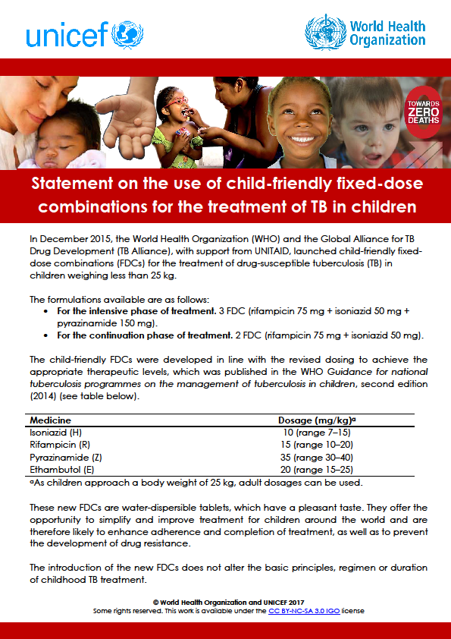
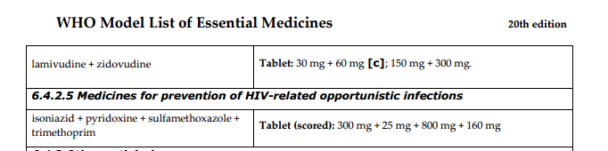
Patient Friendly Regimens
INH+RIF- child friendly FDC
INH+Co-Tx+ViB6-scored tablet
Notes:
Improvements in drug regimens include the availability of the fixed dose combination of isoniazid and rifampicin for children, as well as the fixed dose combination for isoniazid, cotrimixazole and pyridoxin.
Ongoing trials and emerging new evidence give great hopes for even shorter regimens.

Slide 20
Conclusions
Programmatic management of LTBI will be essential to end TB and AIDS;
Scale-up of ART alone will not be enough to end TB/HIV;
Challenges persist in scaling up, including in recording and reporting TB prevention;
The guidelines offer new options for catalyzing the TB prevention response.

Slide 21
Acknowledgements
Meg Doherty, Department of HIV/AIDS, WHO
Haileyesus Getahun, UNICG on AMR Secretariat, WHO
Molebogeng Xheedha Rangaka, Global TB Programme, WHO
Satvinder Singh, Department of HIV/AIDS, WHO
Matteo Zignol, Global TB Programme, WHO

